Slide 1
Gyürki Zoli
@GreenFox

Slide 2
Monday
PWM

Slide 3
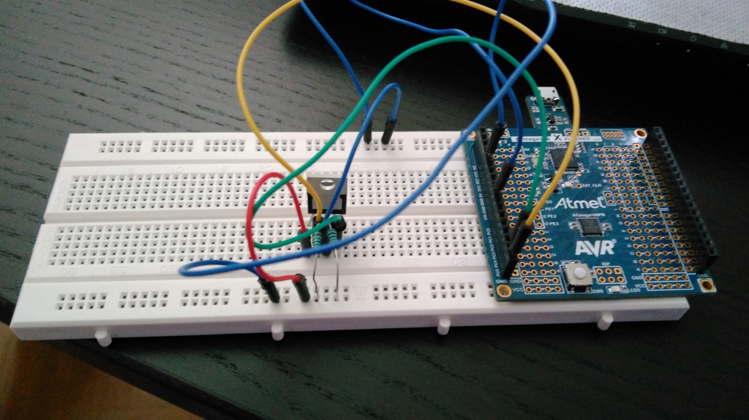
Notes:
Just simply

Slide 4
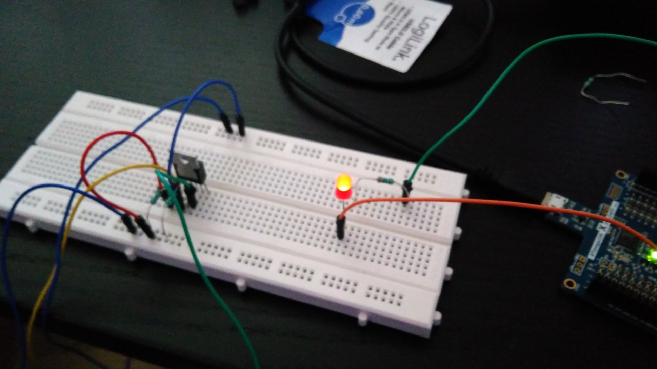
Notes:
With LED – lighting low

Slide 5
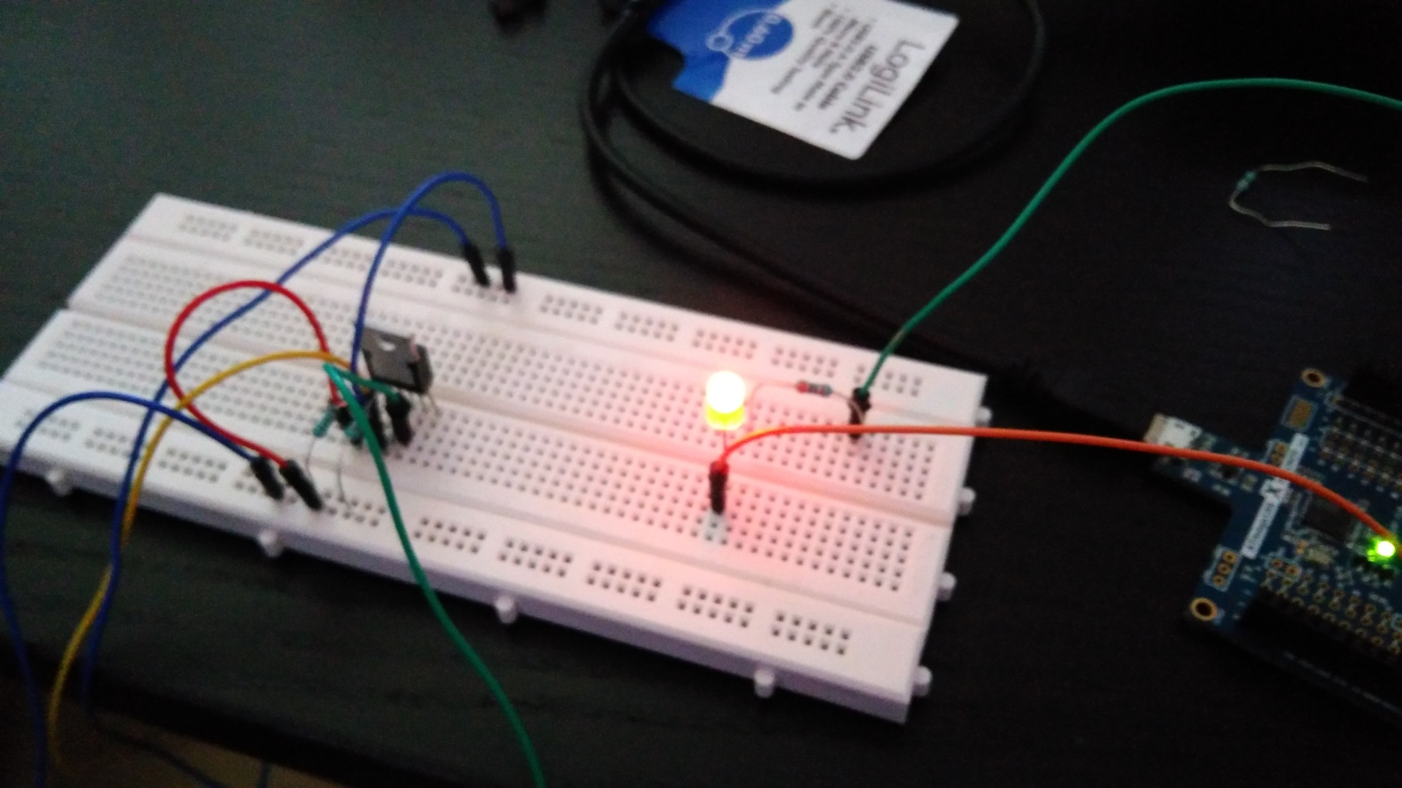
Notes:
Lighting high

Slide 6
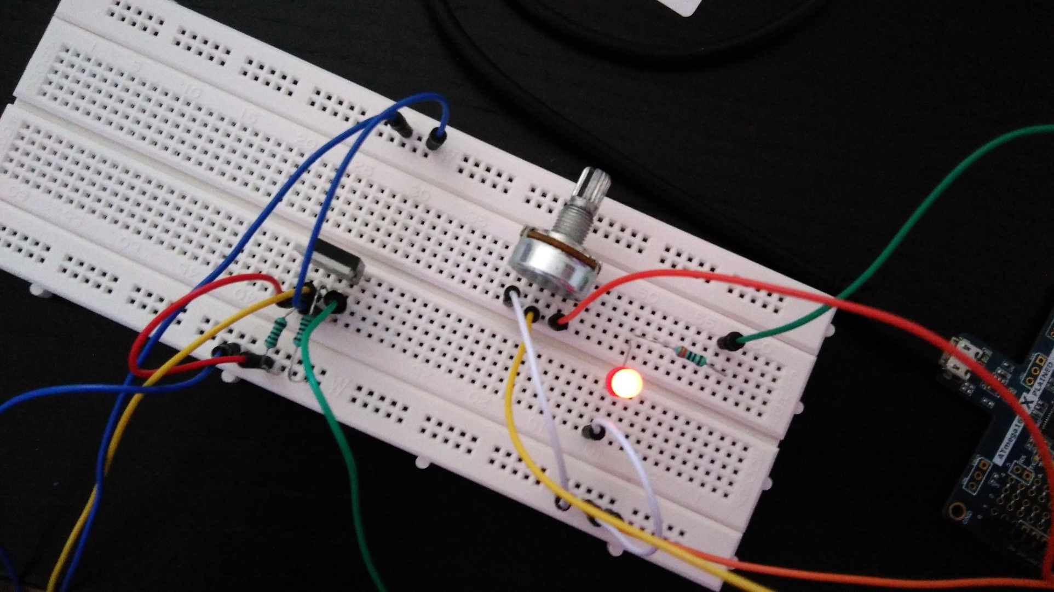
Notes:
After Built in the „poti”

Slide 7
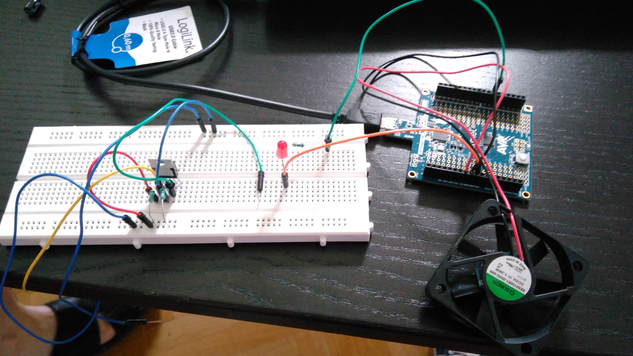
Notes:
And finally the air-propeller

Slide 8
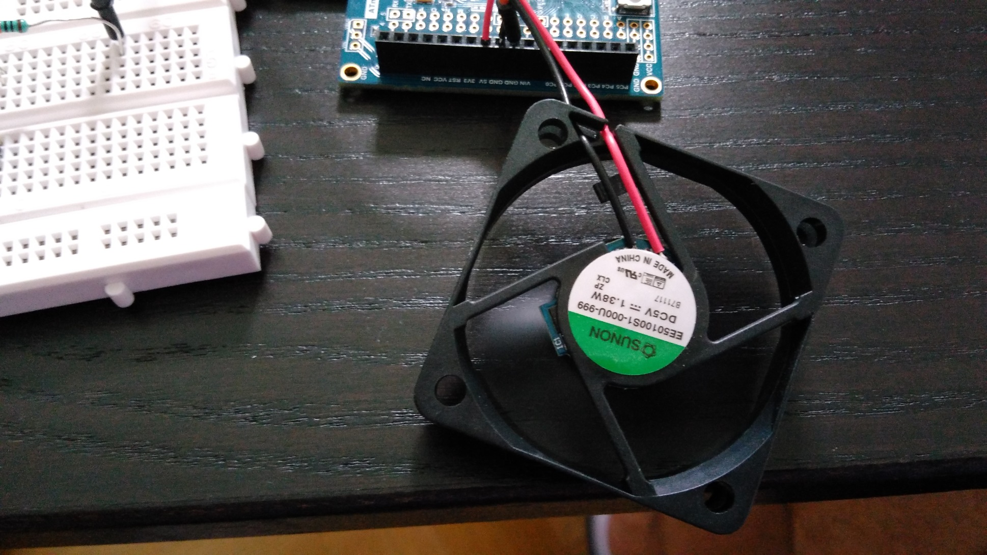
Notes:
It works – rotation ON

Slide 9
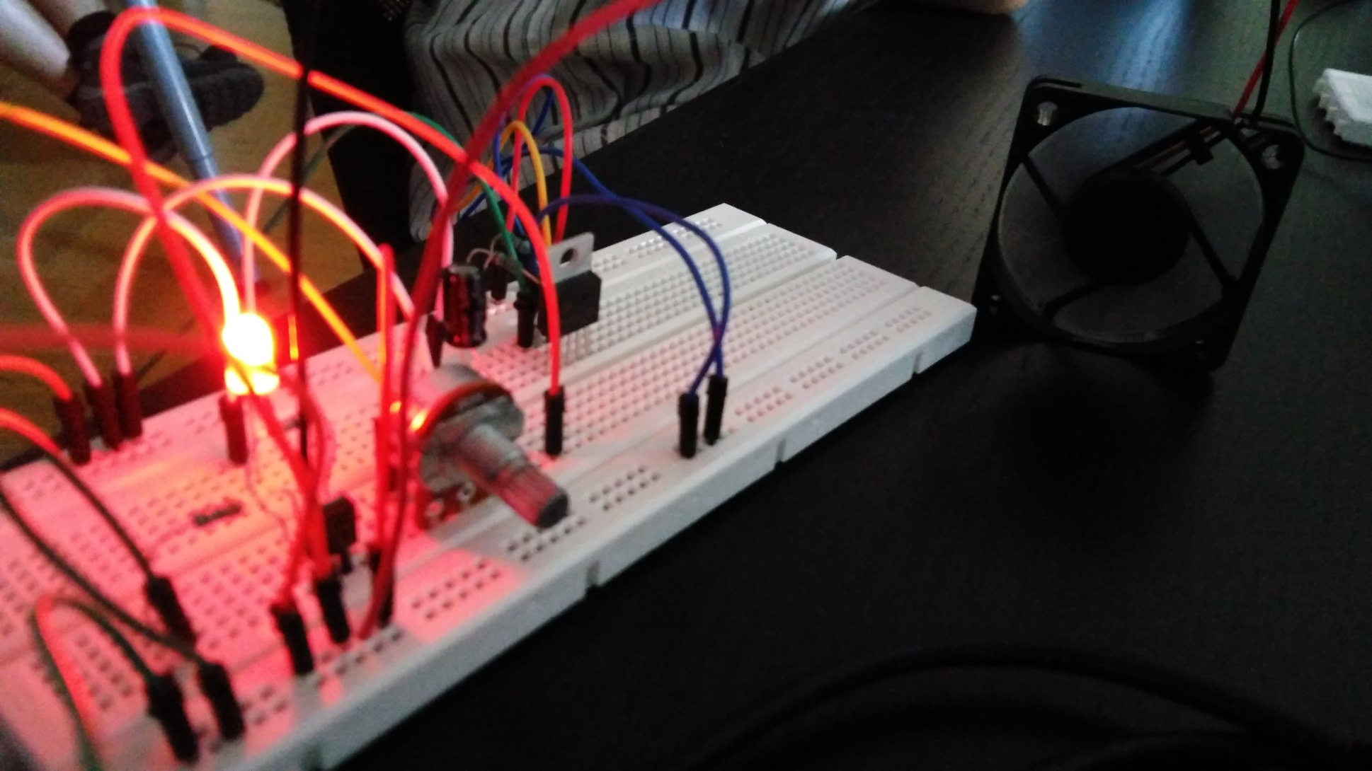
Notes:
Everything connecting to each other – still worked

Slide 10
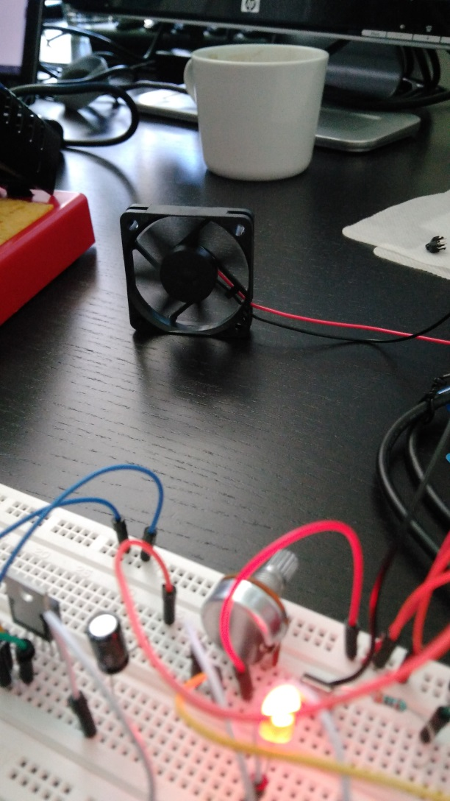
Notes:
From another view

Slide 11
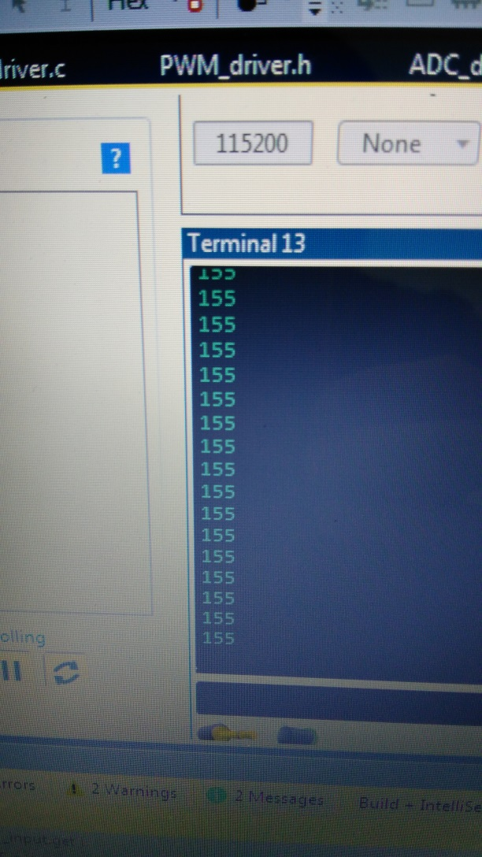
Notes:
My min value when the propeller still roll

Slide 12
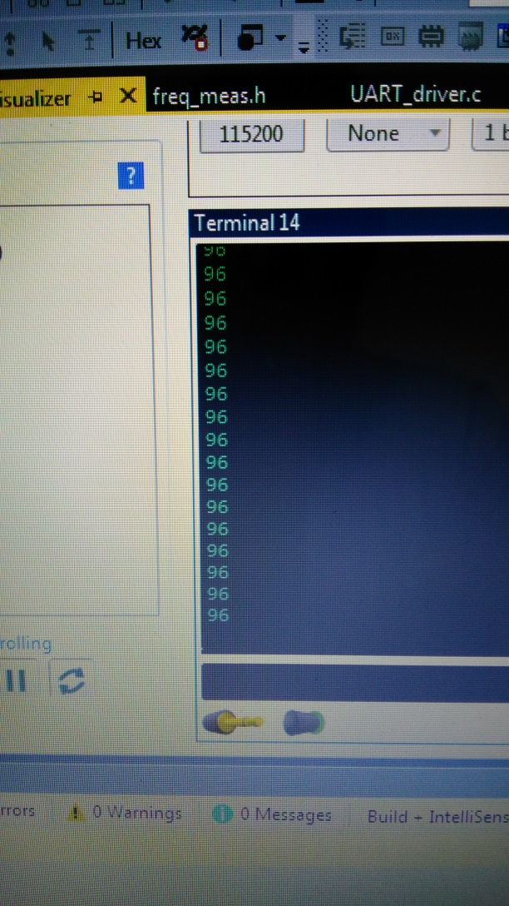
Notes:
It was quite high so Im debugging

Slide 13
Tuesday
FRQ and RPM measurement

Slide 14
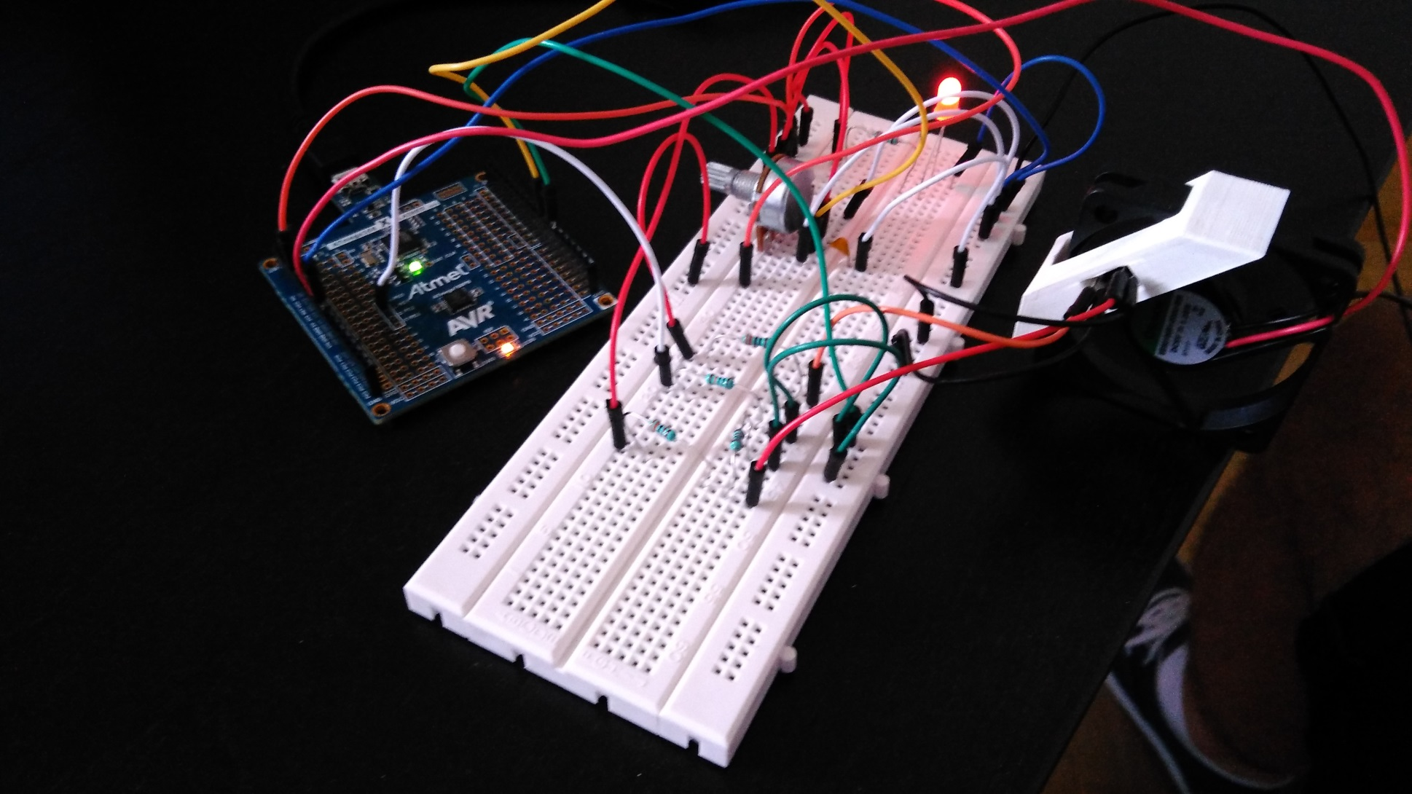
Notes:
Complicated but enjoyable job

Slide 15
wednesday
..oh YOU magical
Notes:
The program and whole day’s activity totally made the feeling

Slide 16
Thursday-Friday
Building, practising, debugging, whatever..

Slide 17
Debuging
Practise
Loop-control
Notes:
Im using color codes that shows my successness

Slide 18
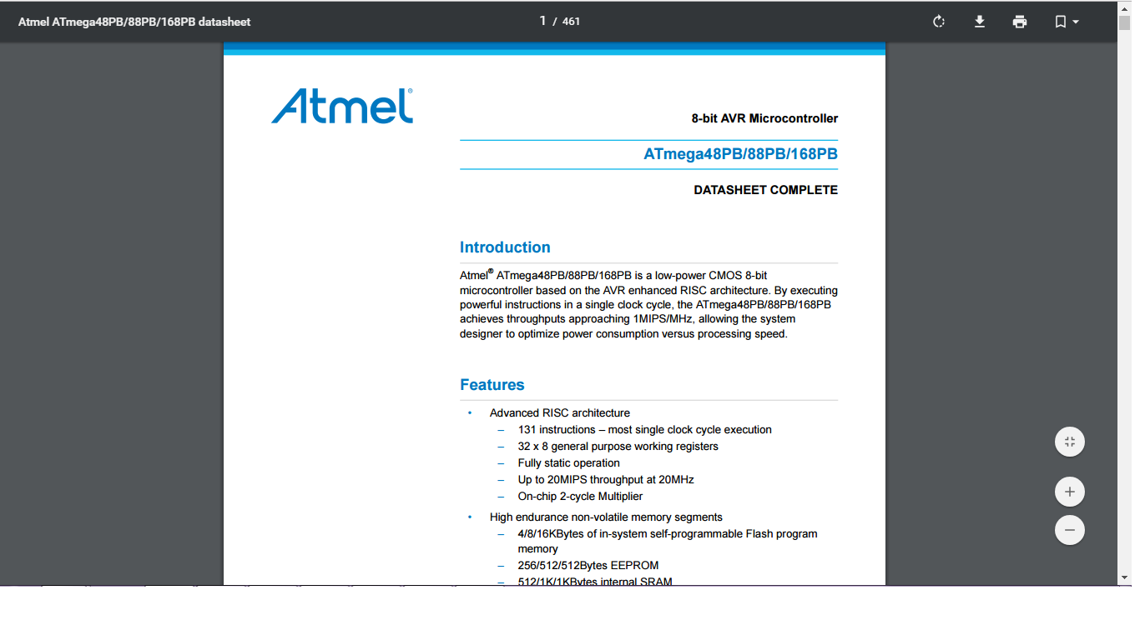
Bro’s for life
Notes:
Stil YET

Slide 19
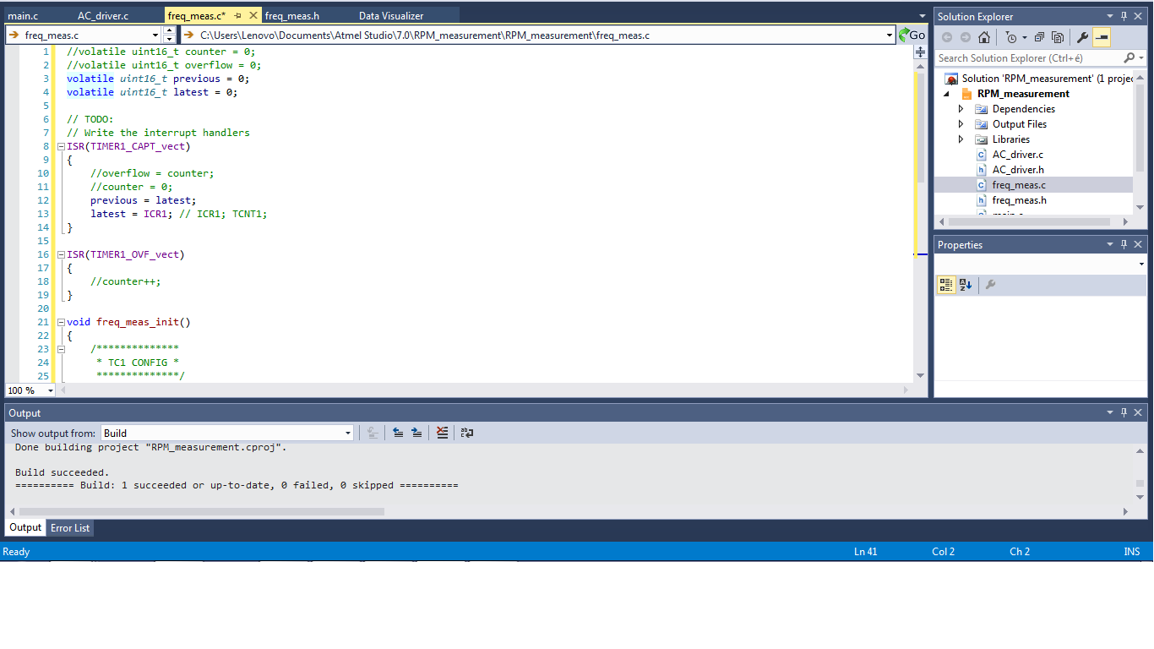
Notes:
…and last: an extra interest
I amputate some parts of the code but also works here
If I take off the overflow interrupt handler from the process -> it can prosper

Slide 20
Thank U & Have a nice weekend!

